Slide 1
CST 204 Database Management Systems
B.Tech. CSE
Semester IV
Viswajyothi College of Engineering and Technology
Sindhu Jose, AP, CSE, VJCET

Slide 2
MODULE 2
Relational Model
Sindhu Jose, AP, CSE, VJCET

Slide 3
Syllabus of Module 2
Structure of Relational Databases - Integrity Constraints, Synthesizing ER diagram to relational schema
Introduction to Relational Algebra - select, project, cartesian product operations, join - Equi-join, natural join. query examples
Introduction to Structured Query Language (SQL), Data Definition Language (DDL), Table definitions and operations – CREATE, DROP, ALTER, INSERT, DELETE, UPDATE.
Sindhu Jose, AP, CSE, VJCET

Slide 4
Introduction to SQL
SQL (Structured Query Language)is a database sub language for querying and modifying relational databases. It was developed by IBM Research in the mid70's and standardized by ANSI in1986.
In the relational model, data is stored in structures called relations or tables. Each table has one or more attributes or columns that describe the table.
SQL language consists of three categories of statements:
Data Definition Language(DDL): used to create, alter and drop schema objects such as tables and indexes etc.
Data Manipulation Language(DML): used to manipulate the data within those schema objects.
Data control language (DCL): It includes commands such as GRANT and REVOKE which mainly deals with rigths , permissions and other controls of database system.
Sindhu Jose, AP, CSE, VJCET

Slide 5
Data Types in SQL Statements
a) CHAR(n) -Character string, fixed length n
b) VARCHAR(n) - Variable length character string, maximum length n.
c) NUMBER(p) - Integer numbers with precision p.
d) BOOLEAN - Boolean variable used to store TRUE, FALSE, NULL
e) DATE - Stores year, month, day, hour, minute and second values
f) BLOB - Binary Large Object (the data type in Oracle for storing binary files like executables, images etc.)
Sindhu Jose, AP, CSE, VJCET

Slide 6
Data Definition Language (DDL):
The SQL data-definition language(DDL) allows the specification of information about relations, including:
►The schema for each relation.
►The domain of values associated with each attribute.
►Integrity constraints
The common DDL commands are
a. CREATE TABLE:
b. ALTER TABLE
c. DROP TABLE
d. TRUNCATE
e.RENAME
Sindhu Jose, AP, CSE, VJCET

Slide 7
1) CREATE
There are two CREATE statements available in SQL:
►CREATE DATABASE
►CREATE TABLE
The CREATE DATABASE statement is used to create a new database in SQL.
Syntax:
CREATE DATABASE database_name;
  Example
CREATE DATABASE university;
The CREATE TABLE statement is used to create a new table.
Syntax:
CREATE TABLE <table name> (column1 datatype(size), column2 datatype(size), column3 datatype(size),………);
Sindhu Jose, AP, CSE, VJCET

Slide 8
Constraints
Constraint specifications add additional restrictions on the contents of the table.They are automatically enforced by the DBMS.
a) Primary Key: Specifies the columns that uniquely identify a row in a table.One or more columns could be part of a primary key.
Syntax:
CREATE TABLE <table name> (column1 datatype(size), column2 datatype(size), column3 datatype(size),………, PRIMARY KEY(coulmn name));
OR
CREATE TABLE <table name> (column1 datatype(size) PRIMARY KEY, column2 datatype(size), column3 datatype(size),………);
Sindhu Jose, AP, CSE, VJCET

Slide 9
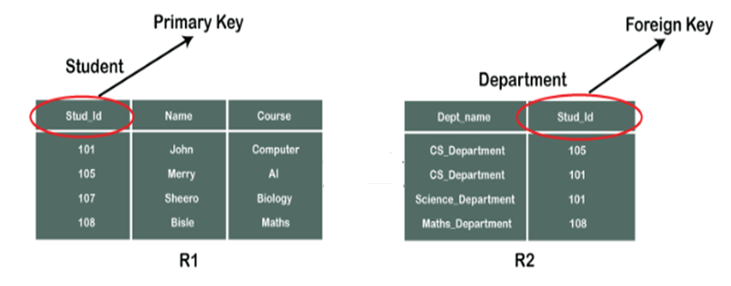
Example: create table Student (Stud_Id number(5) not null, Name varchar(10),Course varchar(10), primary key(Stud_Id));
b) NOT NULL: Specifies that the column that can't be set to null. Normally, primary key columns are declared as NOT NULL(as shown in above Example).
Syntax:
CREATE TABLE <table name> (column1 datatype(size) NOT NULL, column2 datatype(size), column3 datatype(size) ,………);
Sindhu Jose, AP, CSE, VJCET

Slide 10
c) UNIQUE: Specifies that this column has a unique value or null for all rows of the table.
Syntax:
CREATE TABLE <table name> (column1 datatype(size) UNIQUE, column2 datatype(size), column3 datatype (size),………);
d)Foreign Key: Specifies the set of columns in a table that is used to establish the relationship with another table in the database.
Syntax:
CREATE TABLE <table name> (column1 datatype(size) PRIMARY KEY, column2 datatype(size), column3 datatype(size),………………FOREIGN KEY(column-name) REFERENCES < referenced-table>(column name);
Sindhu Jose, AP, CSE, VJCET

Slide 11
Example: create table Department (Dept_name varchar(15) not null, Stud_Id number(10), foreign key (Stud_Id) references STUDENT(Stud_Id));
e)CHECK: Specifies a user defined constraint, known as a check condition. The CHECK specifier is followed by a condition enclosed in parentheses.
Syntax:
CREATE TABLE <table name> (column1 datatype(size) CHECK(Condition), column2 datatype(size), column3 datatype(size),………);
Sindhu Jose, AP, CSE, VJCET

Slide 12
2) ALTER TABLE (Use ADD, DROP, MODIFY, RENAME with ALTER as shown below)
The ALTER TABLE statement is used to change the table definition.
To add new column
ALTER TABLE<table name> ADD column name datatype(size);
To add Primary key
ALTER TABLE <table name> ADD PRIMARY KEY(column name);
To add Foreign key
ALTER TABLE <table name> ADD FOREIGN KEY (column name) REFERENCES <table name> (column name);
To remove a Foreign key
ALTER TABLE <table name> DROP <foreign key name>;
To modify the existing columns in a table
ALTER TABLE <table name> MODIFY column_name column_type;
To rename a table
ALTER TABLE <table name> RENAME TO <new table name>;
Sindhu Jose, AP, CSE, VJCET

Slide 13
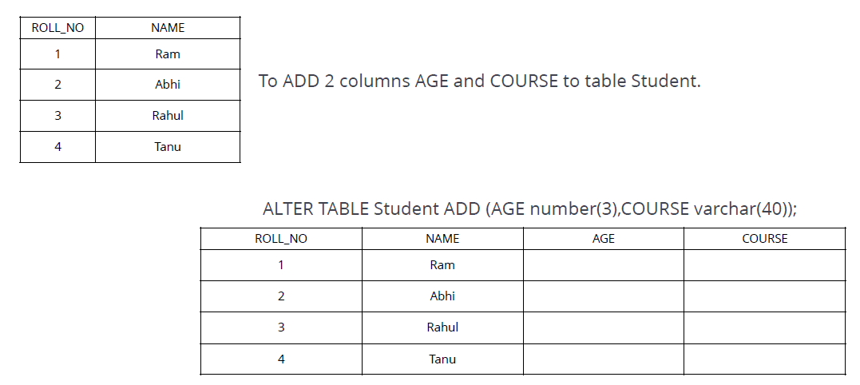
Example 1: Alter(To add new column)
Sindhu Jose, AP, CSE, VJCET

Slide 14
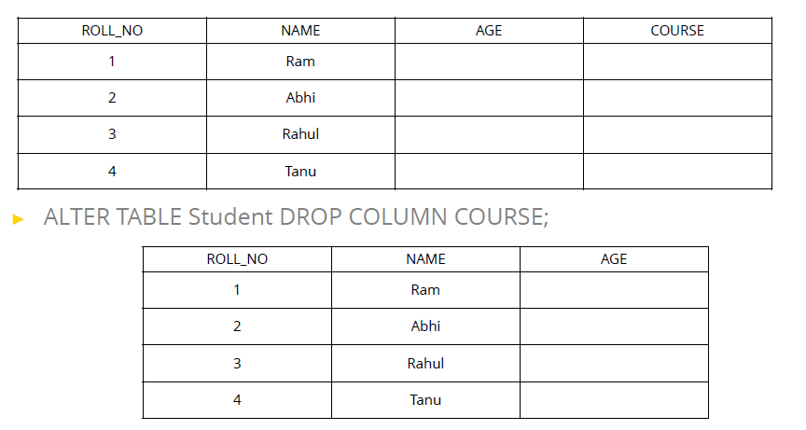
Example 2 :Alter (To drop a column)
Sindhu Jose, AP, CSE, VJCET

Slide 15
Example 3: Alter
To add primary key to a table
ALTER TABLE Student ADD PRIMARY KEY (Stud_Id);
To add Foreign key to a table
ALTER TABLE Department ADD FOREIGN KEY (Stud_Id)
REFERENCES Student(Stud_Id);
To remove a Foreign key
ALTER TABLE Department DROP FOREIGN KEY Stud_Id;
To modify the existing columns in a table
ALTER TABLE Student MODIFY COURSE varchar(20);
To rename a table
ALTER TABLE Department RENAME TO Dept;
Sindhu Jose, AP, CSE, VJCET

Slide 16
3) DROP TABLE
DROP is used to delete a whole database or just a table.
The DROP statement destroys the objects like an existing database, table, index, or view.
Syntax:
To drop a table
DROP TABLE <table name>;
To drop a database
DROP DATABASE <database_name>;
4)TRUNCATE TABLE COMMAND
The SQL TRUNCATE TABLE command is used to delete complete data from an existing table.(empty for reuse).
Syntax:
TRUNCATE TABLE <table name>;
Sindhu Jose, AP, CSE, VJCET

Slide 17
DROP Vs TRUNCATE
You can also use DROP TABLE command to delete complete table but it would remove complete table structure form the database and you would need to re-create this table once again if you wish you store some data.
Truncate preserves the structure of the table for future use, unlike drop table where the table is deleted with its full structure.
Truncate is normally ultra-fast than DROP and its ideal for deleting data from a temporary table.
Table or Database deletion using DROP or TRUNCATE statement cannot be rolled back, so it must be used wisely.
Sindhu Jose, AP, CSE, VJCET

Slide 18
DML Statements
The DML statements are used to manipulate (store and maintain) the data in database tables.Common DML statements are:
a. INSERT
b. UPDATE
c. DELETE
  d. SELECT
Sindhu Jose, AP, CSE, VJCET

Slide 19
a. lNSERT
The INSERT INTO statement is used to insert new records in a table.
It is possible to write the INSERT INTO statement in two ways:
1. Specify both the column names and the values to be inserted:
Syntax :
INSERT INTO table_name (column1, column2, column3, ...) VALUES(value1, value2, value3, ...);
2. If you are adding values for all the columns of the table, you do not need to specify the column names in the SQL query. Make sure that the order of the values is in the same order as the columns in the table.
Syntax:
INSERT INTO< table_name> VALUES (value1, value2, value3, ...value n);
Sindhu Jose, AP, CSE, VJCET

Slide 20
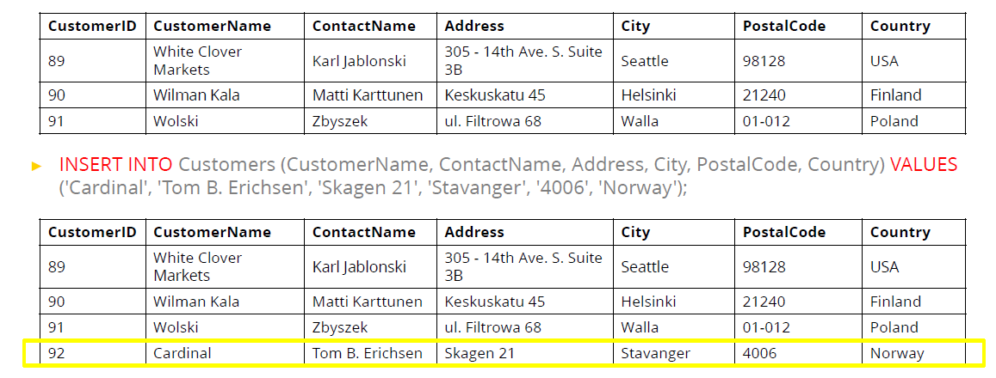
Example 1: Insert
Sindhu Jose, AP, CSE, VJCET

Slide 21
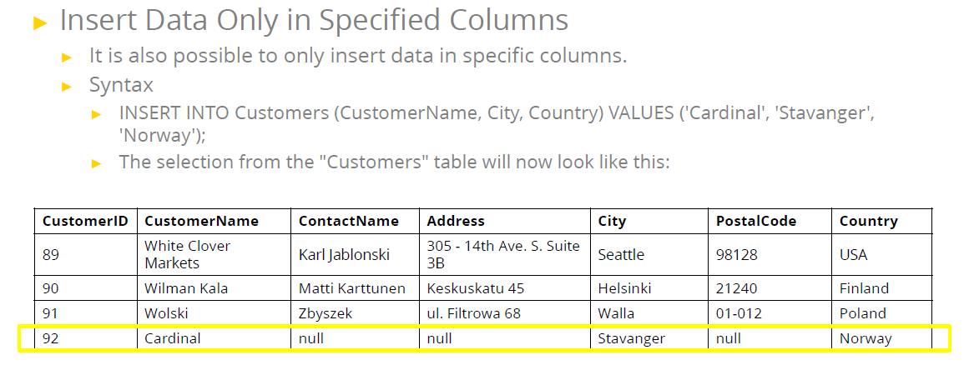
Example 2:
Sindhu Jose, AP, CSE, VJCET

Slide 22
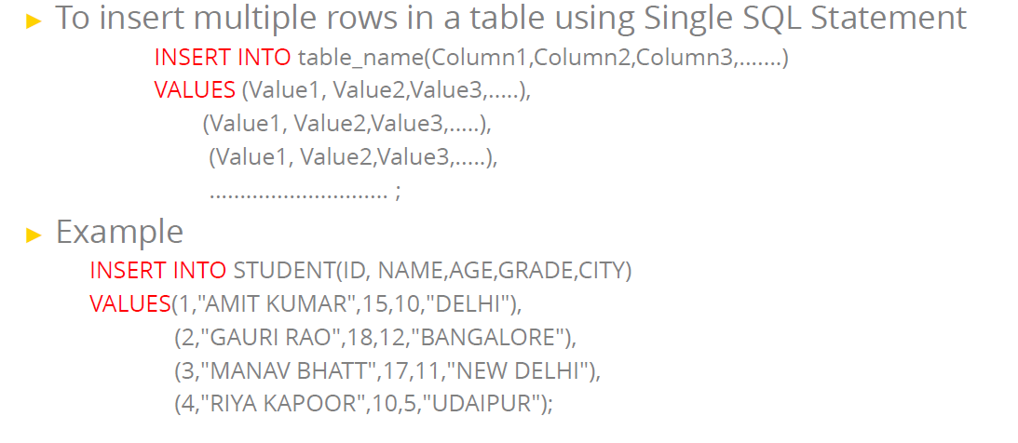
Example 3: Insert
Sindhu Jose, AP, CSE, VJCET

Slide 23
b. UPDATE
Updating allows us to change some values in a tuple without necessarily changing all.
We can update single columns as well as multiple columns using UPDATE statement as per our requirement.
Syntax
UPDATE <table_name> SET column1 = value1, column2 = value2, ...WHERE <condition>;
Note: The WHERE clause specifies which record(s) that should be updated. If you omit the WHERE clause, all records in the table will be updated!
Example: Update the date of birth of employee 1090 to15-Oct-1979.
UPDATE EMPLOYEE SET DATE_OF_BIRTH=’15-OCT-1979’ WHERE EMPLOYEE_ID=1090;
Sindhu Jose, AP, CSE, VJCET

Slide 24
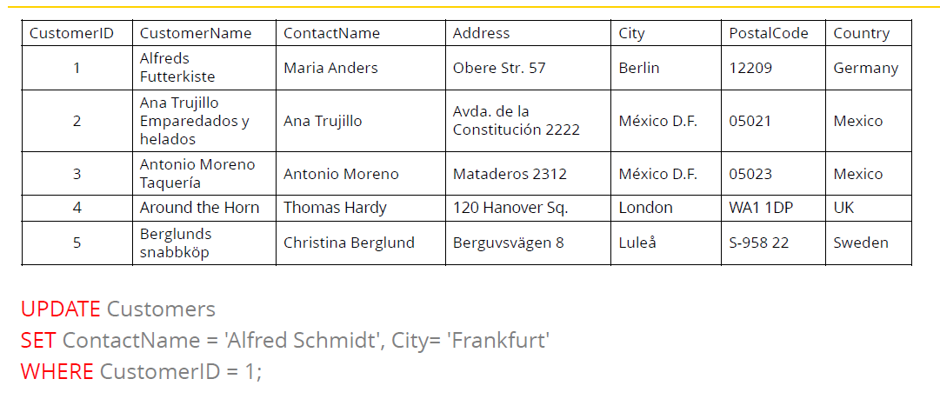
Example 1 : Update
Sindhu Jose, AP, CSE, VJCET

Slide 25
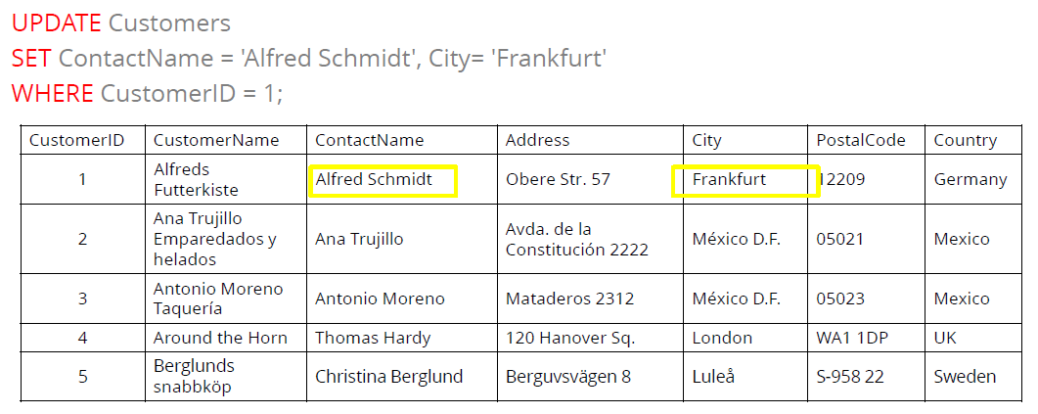
Result
Sindhu Jose, AP, CSE, VJCET

Slide 26

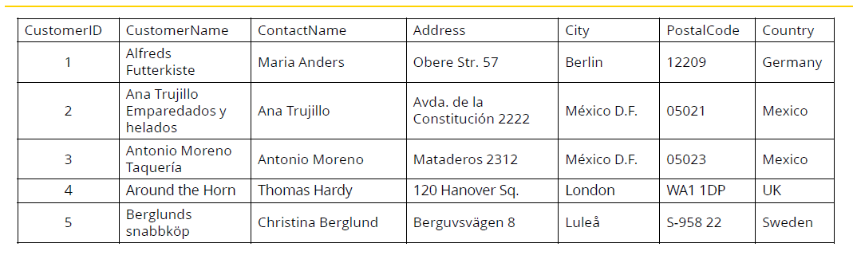
Example 2: Update
Sindhu Jose, AP, CSE, VJCET

Slide 27
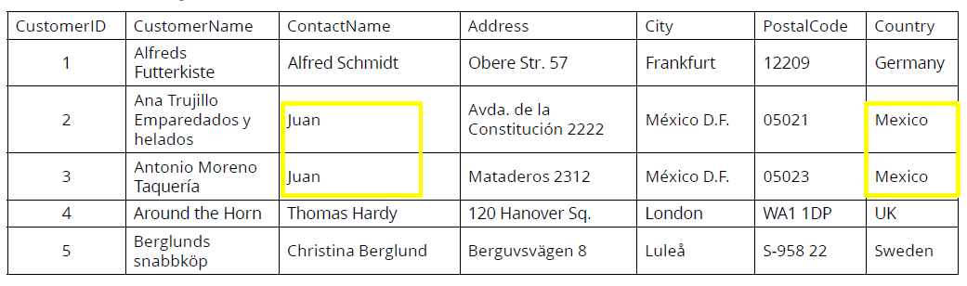
Result
Sindhu Jose, AP, CSE, VJCET

Slide 28
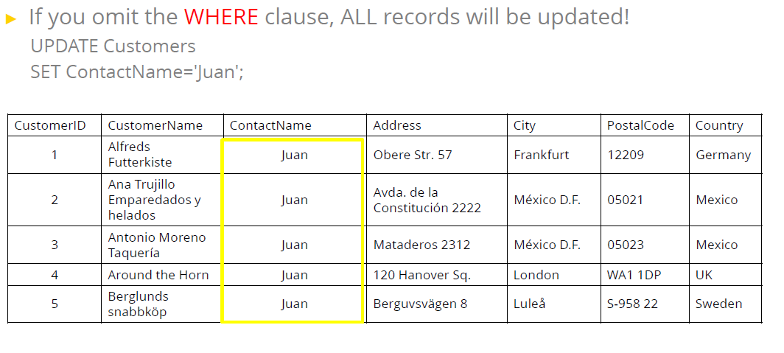
Sindhu Jose, AP, CSE, VJCET

Slide 29
c. DELETE
The DELETE Statement in SQL is used to delete existing records from a table.
We can delete a single record or multiple records depending on the condition we specify in the WHERE clause.
Syntax
DELETE FROM <table_name> WHERE <condition>;
Note: The WHERE clause specifies which record(s) should be deleted. If you omit the WHERE clause, all records in the table will be deleted!
Sindhu Jose, AP, CSE, VJCET

Slide 30
Delete Specific rows
DELETE FROM <table name> WHERE <condition>;
To Delete all rows
DELETE * FROM <tablename>;
OR
DELETE FROM <tablename>;
Sindhu Jose, AP, CSE, VJCET

Slide 31
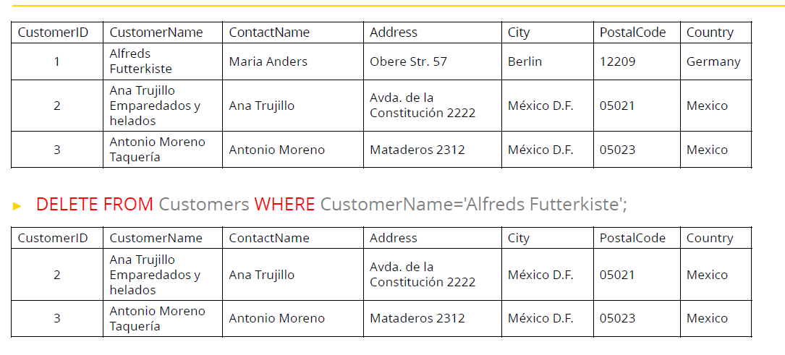
Example 1: Delete
Sindhu Jose, AP, CSE, VJCET

Slide 32
d. SELECT
The SQL SELECT statement queries data from tables in the database. The statement begins with the SELECT keyword. The basic SELECT statement has 3 clauses:
1.SELECT – specifies the table columns retrieved
2. FROM - specifies the tables to be accessed
3. WHERE – specifies which rows in the FROM tables to use
Syntax
SELECT <attribute list> FROM <table name> WHERE <condition>;
To select the whole table
SELECT * FROM <table name>;
Sindhu Jose, AP, CSE, VJCET

Slide 33
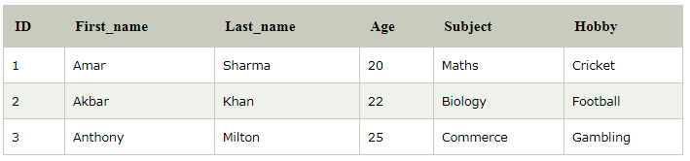
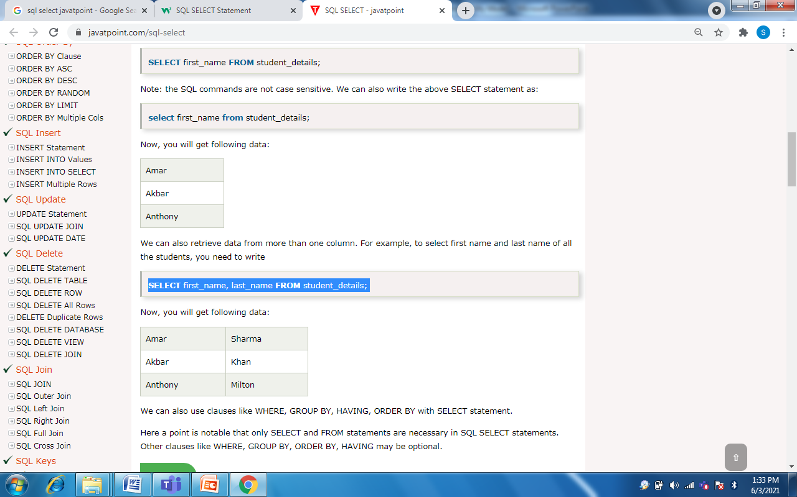
Example 1: Select
Student
SELECT first_name, last_name FROM Student;
Sindhu Jose, AP, CSE, VJCET

Slide 34
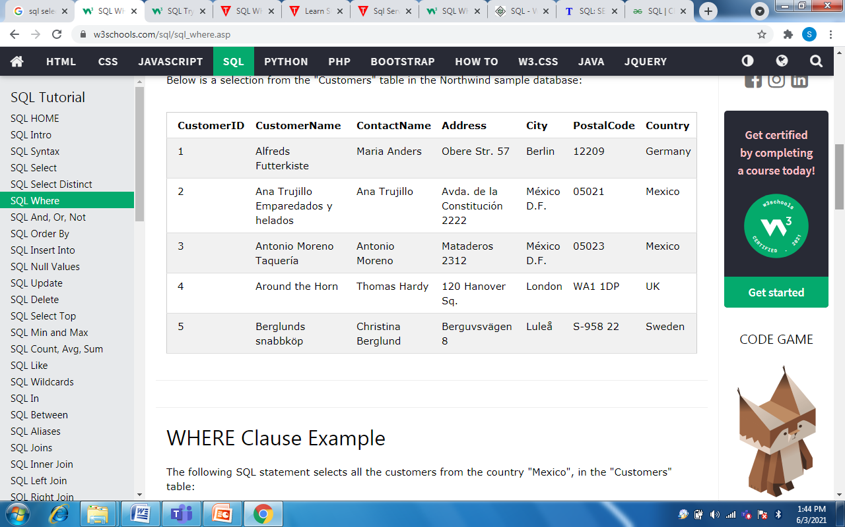
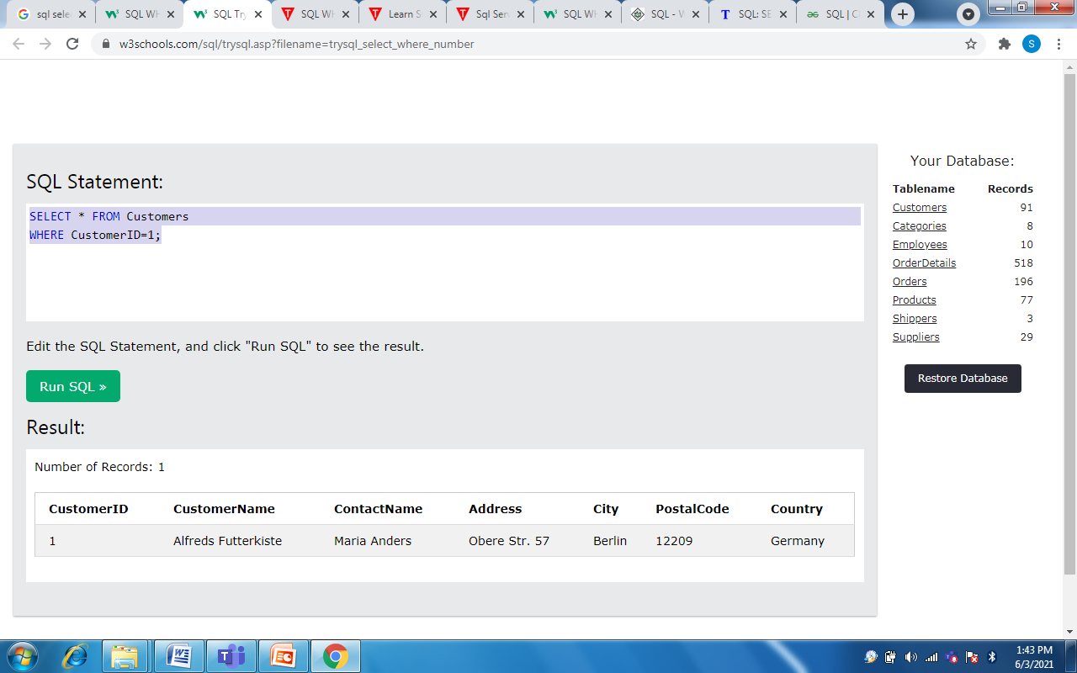
Example 2: Select
SELECT * FROM Customers WHERE City=‘Berlin’;
Output
Sindhu Jose, AP, CSE, VJCET

Slide 35
Example 3: Select
SELECT * FROM Customers;
Customers
Output
Sindhu Jose, AP, CSE, VJCET

